Slide 1
List of Hardware
Roller Lever Micro Switches
Force-Sensitive Resistors
Green and Red LEDs
Resistors (220Ω and 330Ω)
Female to Female Cables

Slide 2
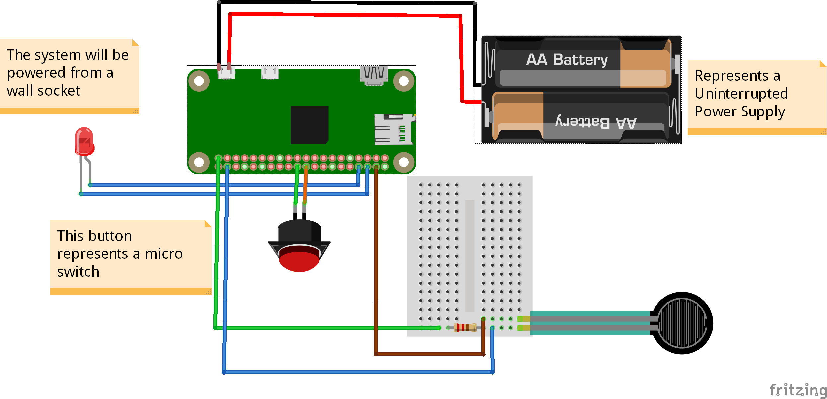
Fritzing Diagram

Slide 3
Powering the Device
The device will be plugged into the wall.
The device will use an Uninterruptible Power Supply (UPS) to handle loss of power. This will require 2 rechargeable batteries.

